Slide 1
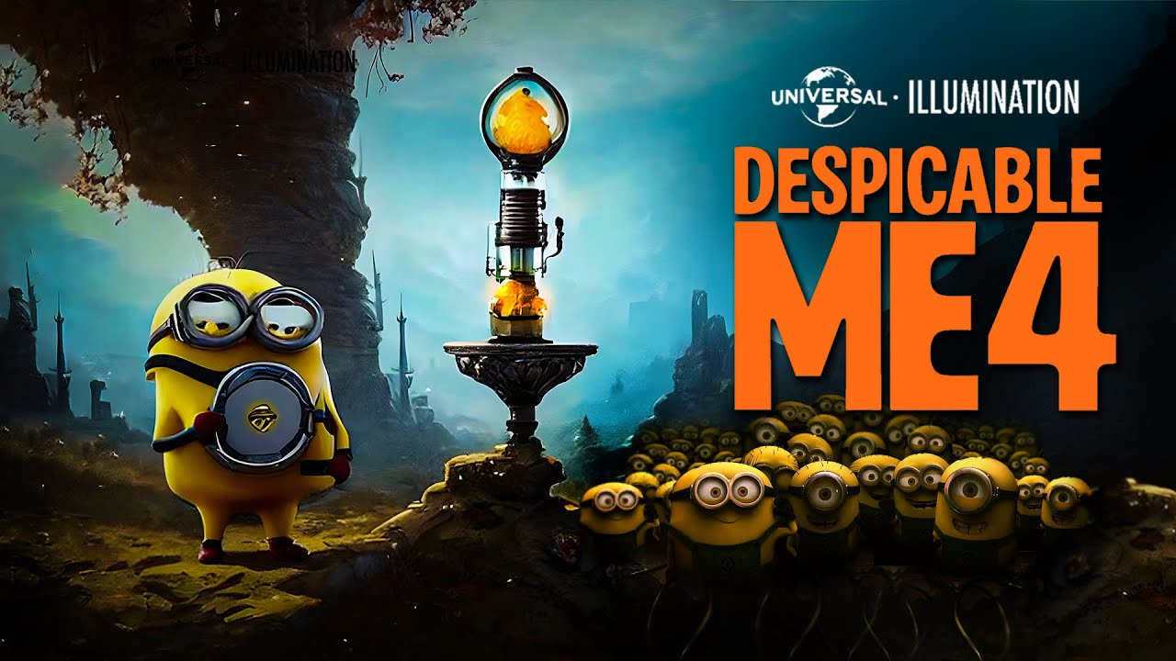
Twitter Despicable Me 4 hashtag analysis
Presented by: Anna Nguyen
Date: June 12, 2024

Slide 2
Introduction
Analyze Despicable Me 4 hashtag on Twitter from Jun 2 to Jun 8, 2024 to gather engagement metrics such as number of posts, total likes, total comments, etc for data analysis to increase content engagement.

Slide 3
Methodology
Data collection: using filter options on Twitter to filter out one week period and the keyword, then click on each post individually to record relevant metrics
Data analysis: average, count, sum, top 3, number of posts per specific time, correlation

Slide 4
Key findings and insights
People love watching and liking video, pictures if the content is about announcement or expressing thoughts
Posting time does not affect the popularity of the post
The more likes there are, the more reposts there are
Short clips, pictures (including memes), and gaming contents draw people to view and like the post

Slide 5
Recommendations
We can firstly focus on creating contents related to announcement or games, in a short video or picture formats. Time of the day does not matter.

Slide 6
Conclusion
If people like a content, they are more likely to repost it, more so than write a comment on that post.
If a content is good to the naked eyes, the audience will like and comment on it regardless of time of day
Short clips and pictures seem attractive to the audience, perhaps because quick and easy illustration or good use/blend of color and texts draw people to that content within a few seconds
People love hearing news and playing games because these things release chemicals in our brain that make us excited, hence the users are more likely to engage in any contents related to announcement and games

Slide 7
Thank you for listening!

